Slide 1

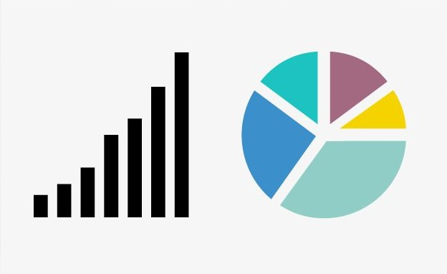
Student Details
Name: Shubham Vijay Dhopat
SkillsBuild Email ID: shubhamdhopat@gmail.com
College Name: Atharva college of Engineering,Mumbai
College State: Maharashtra
Internship Domain: Data Analytics(DA)
Internship start Date: 12/06/2023
Internship End Date: 24/07/2023

Slide 2

PROJECT TITLE: CASE STUDY: ANALYSIS OF SUPERSTORE DATASET
Introduction:
The goal of this project is to conduct a comprehensive analysis of the Sample
Superstore dataset to gain valuable insights into Sales trends and Profitability of the store.
Sales Analysis: Analyze sales metrics, trends, and factors influencing sales fluctuations.
Profit Analysis: Analyze the profit and factors affecting profit of various items in the store.
The Superstore dataset encompasses a wide range of information, including sales data, customer demographics, product categories, and geographical regions. By leveraging this dataset, our objective is to identify areas for improvement and provide data-driven recommendations to optimize the performance of the store. The purpose of this report is to present our findings and recommendations based on the analysis of this dataset.

Slide 3

AGENDA
Introduction to the Project- Analysis of Superstore Dataset
Project Overview- Purpose, Scope and Objective
End Users
Solution and Value Proposition
Customization of the Project & Code Snippets
Modelling & Insights
Results of Analysis – Key Insights, Actionable Insights, Customized Solutions
Relevant Links

Slide 4
PROJECT OVERVIEW
PURPOSE:
The purpose of the project is to perform Descriptive Data Analysis on Superstore data to gather relevant
insights regarding sales and profit of the superstore-
Extract, Transform and Load (ETL) the data
Perform Exploratory Data Analysis (EDA) on the dataset
SCOPE:
The project focused on understanding sales trends and profitability across regions, cities, categories, and sub-
categories within the Superstore dataset.
Goal:
Perform Descriptive Analysis of the ‘SampleSuperstore’ Dataset using Python
Highlight the insights regarding Sales and Profit of the Superstore as gathered from analysing the data.
Tools Used: Python and libraries- Numpy, Pandas, Matplotlib and Seaborn

Slide 5
PROJECT OVERVIEW
OBJECTIVES:
Understand, clean and visualize the dataset to gain insights from the data
Analyze the Sales and Profit based on different regions, categories and other parameters, that is-
Analyze sales patterns in different regions and cities to identify the highest-selling areas.
Determine the top-selling categories and sub-categories within the Superstore dataset.
Assess the profitability of different products and identify the most profitable areas.
Find the Cities, States and Regions having maximum Profit and maximum Sales.
Provide data-driven insights and recommendations for optimizing sales and improving profitability.

Slide 6
WHO ARE THE END USERS of this project?
Managenent Team: The project's analysis and insights are primarily aimed at the management team of Sample Superstore. They are the key decision-makers who will utilize the findings to make strategic decisions and implement changes to improve the company's operations, sales, and profitability
Buisness Analyst: The Business analysts within Sample Superstore may use the project results to gain a deeper understanding of customer behavior, product performance, and sales trends. They can further analyze the insights and incorporate them into their reports and recommendations.
Marketing Team: The marketing team can benefit from the project's findings to develop targeted marketing strategies based on customer segmentation and preferences. The analysis can help them identify potential customer segments to focus on and tailor marketing campaigns accordingly.

Slide 7
WHO ARE THE END USERS of this project?
Sales Team: The sales team can leverage the project's insights to optimize their sales approach. By understanding sales trends, product performance, and customer behavior, they can adapt their sales strategies to better meet customer demands and increase sales revenue.
Operations Team: The operations team can utilize the project's recommendations to streamline processes, improve inventory management, and optimize supply chain operations. They can identify areas of improvement based on the analysis of product categories, profitability, and customer satisfaction.
Finance Team: The finance team can benefit from the project's analysis of profitability and cost factors. The insights can help them identify cost-saving opportunities, evaluate the impact of discounts and shipping costs, and optimize pricing strategies.
Data Analysts/Scientists: Data analysts or data scientists within the organization can use the project as a reference for similar analyses and as a benchmark for future data-driven projects. They can also contribute their expertise in analyzing the dataset and extracting insights.

Slide 8
YOUR SOLUTION AND ITS VALUE PROPOSITION
Solution: The project involved a comprehensive analysis of the Superstore dataset to gain insights into sales trends and profitability of the Superstore. This analysis utilized various Python libraries like NumPy, Pandas, statistical and data mining techniques and visualization tools such as Matplotlib and Seaborn to efficiently analyze the Superstore dataset.
Value Proposition: The analysis provides data-driven recommendations for decision making to -
optimize sales,
improve profitability, and
inform business strategies for personalized marketing.
The use of Python libraries and visualization tools enhances the efficiency and effectiveness of the
analysis by making it easily interpretable.

Slide 9
How did you customize the project and make it your own
Personalized Project Objectives: I would review the initial project objectives and consider any additional goals or specific areas of focus that align with my expertise or interests.
Creative Data Visualization: To present the analysis findings in a visually appealing and easily understandable manner, I might explore creative data visualization techniques beyond the typical charts and graphs. This could involve using interactive dashboards, storytelling techniques, or infographics to engage stakeholders and convey the insights effectively.
Domain-specific Insights: Drawing from my domain knowledge or prior experience, I would provide context-
specific insights that go beyond the basic analysis
Real-world Implementation Strategies: While recommendations are a crucial part of the project, I would ensure they are practical and actionable. This could involve providing specific implementation strategies, such as launching loyalty programs, optimizing pricing structures, or improving inventory management.

Slide 10
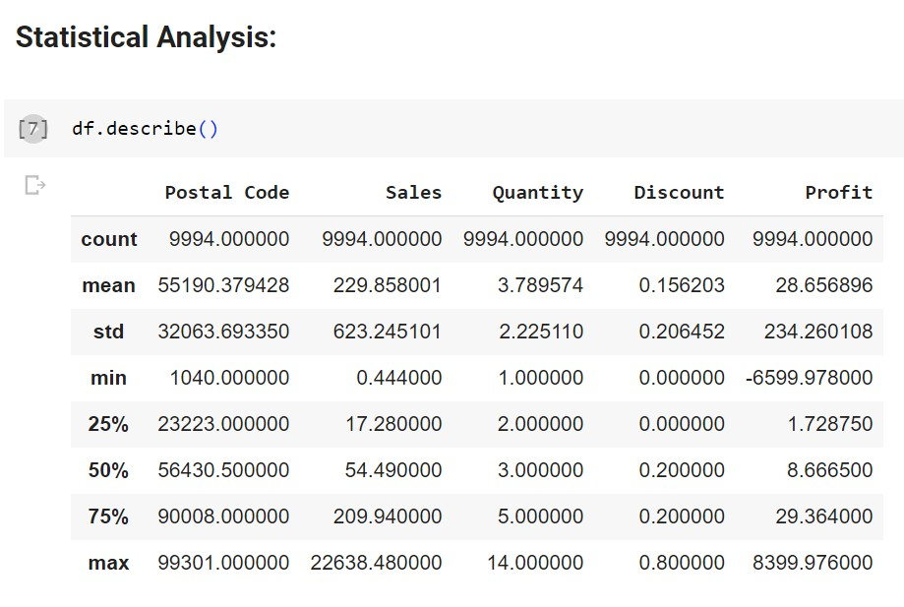
MODELLING AND INSIGHTS
The modelling techniques used for data analysis in this project are –
Statistical Analysis:
Used to discover correlations, trends, and
patterns within the Superstore dataset. These techniques helped in understanding the impact of various factors on Sales and
Profitability.

Slide 11
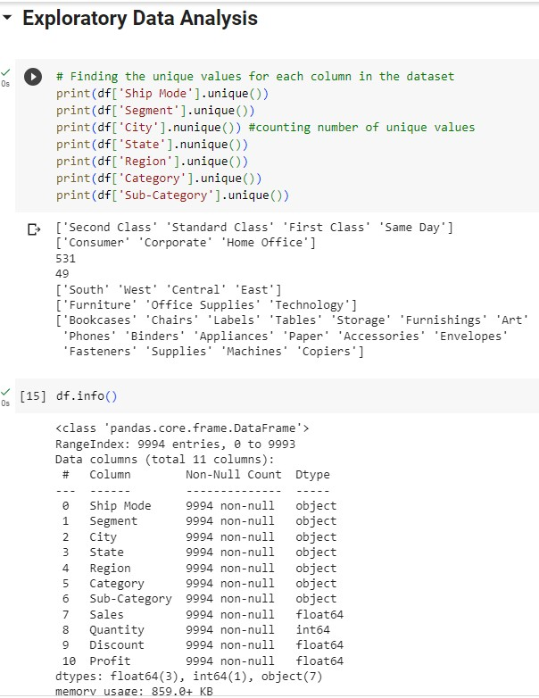
MODELLING AND INSIGHTS
Exploratory Data Analysis (EDA): EDA techniques were employed to gain initial insights into the dataset. This included data visualization through charts, graphs, and plots to understand the distribution of variables, identify outliers, and detect patterns or relationships between different variables.

Slide 12
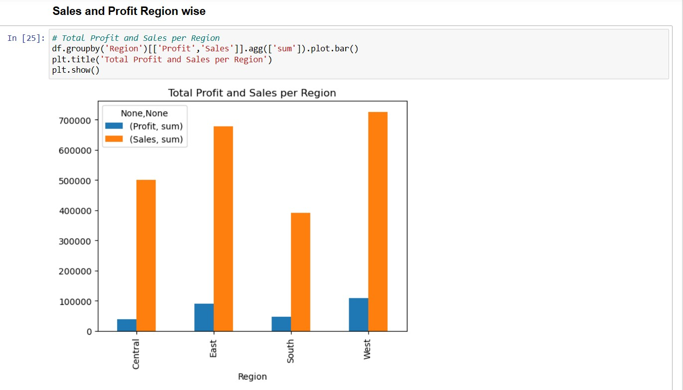

Slide 13
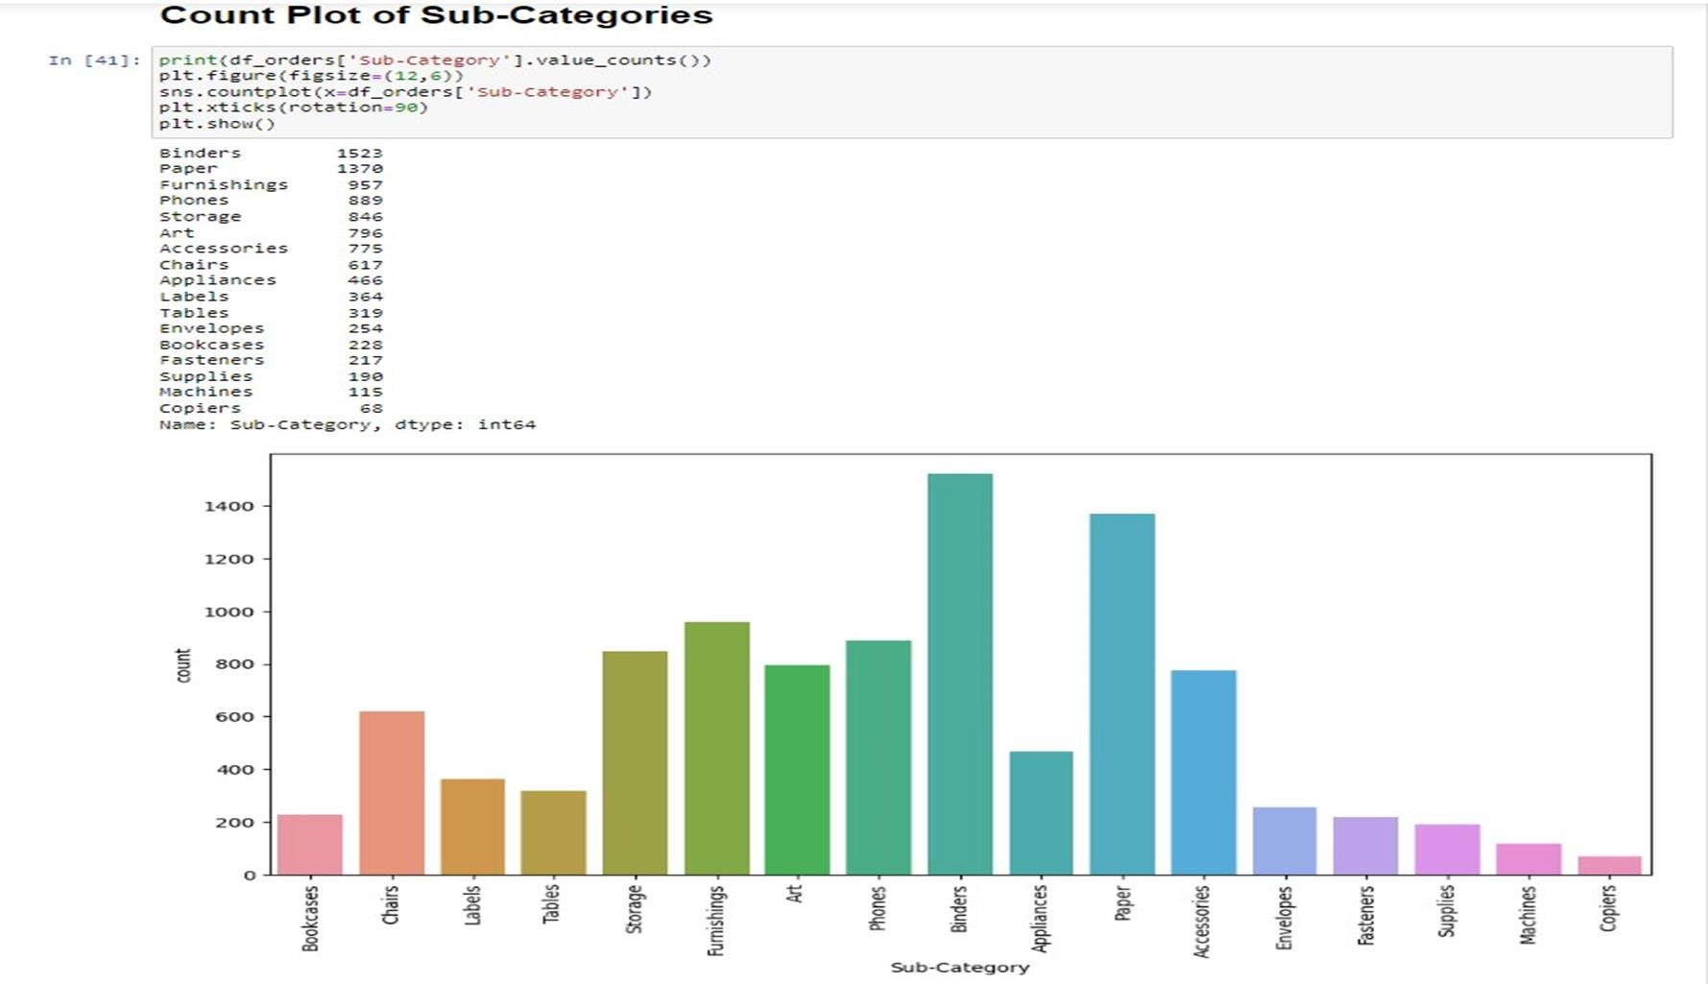

Slide 14
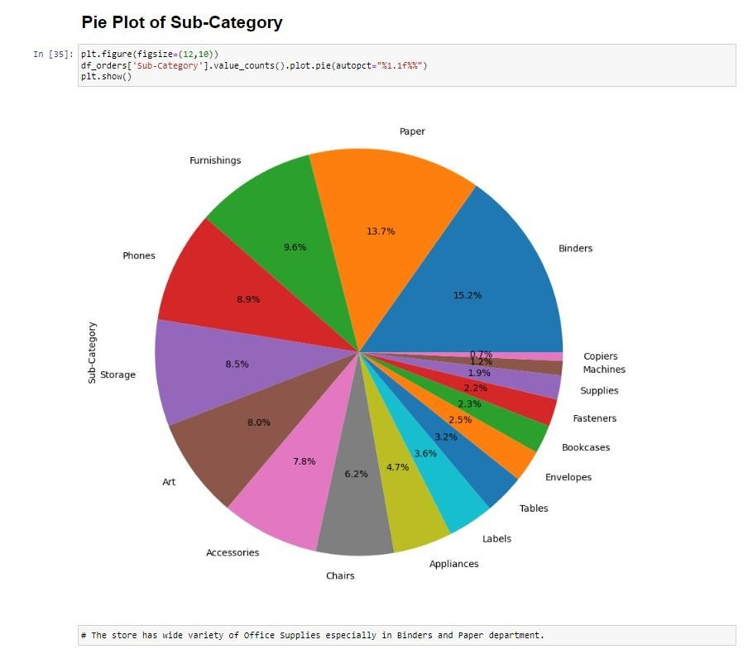
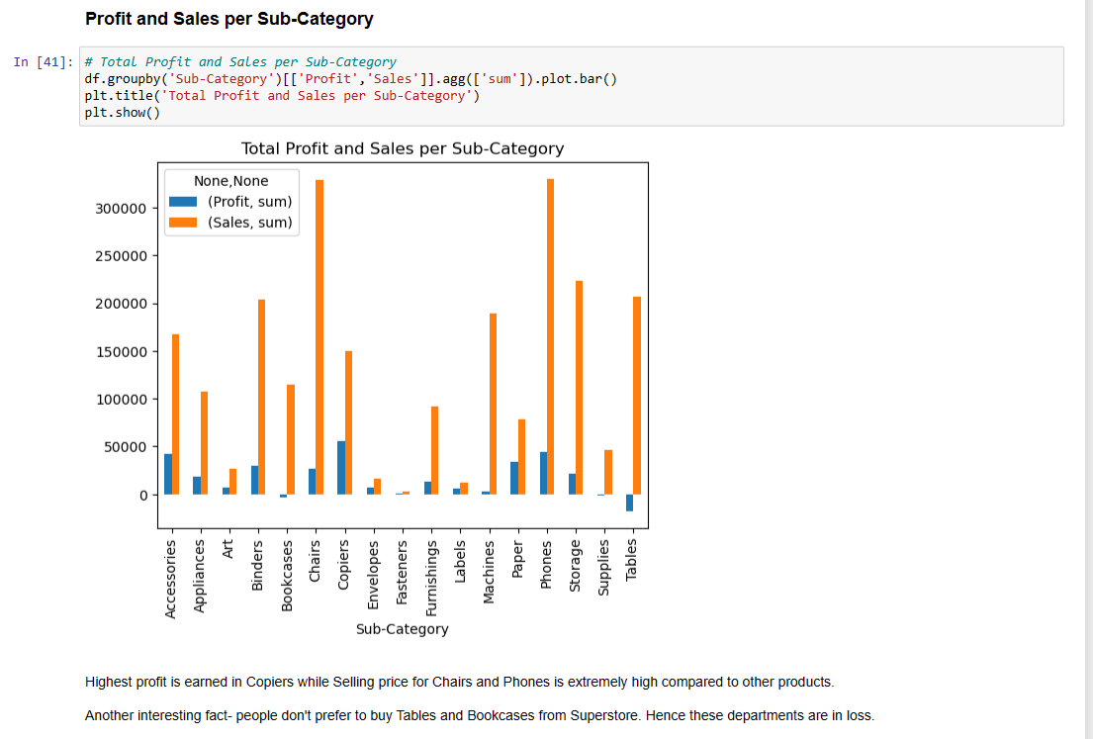

Slide 15
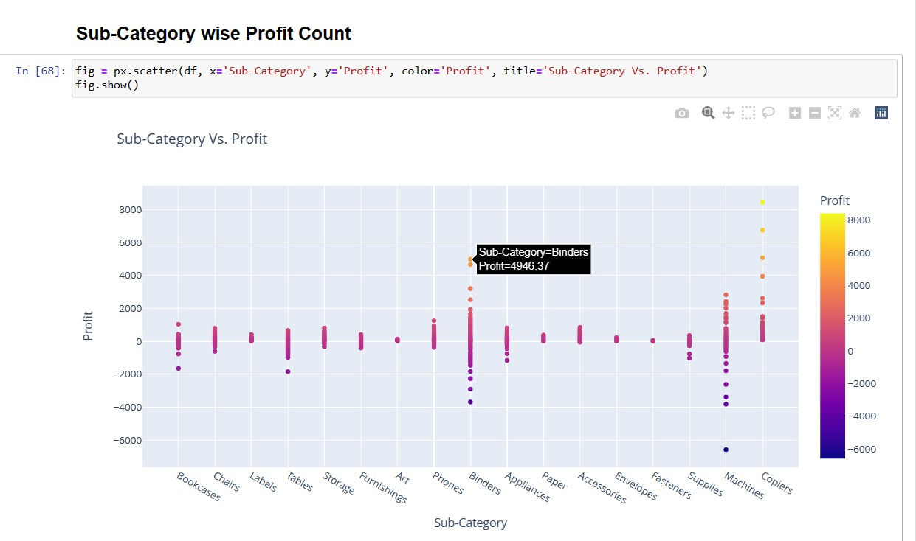

Slide 16
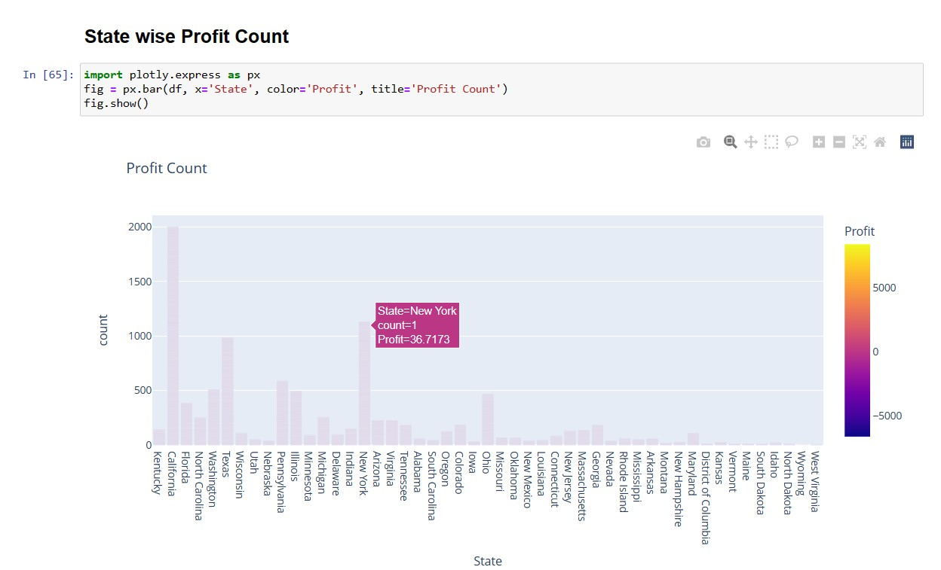

Slide 17
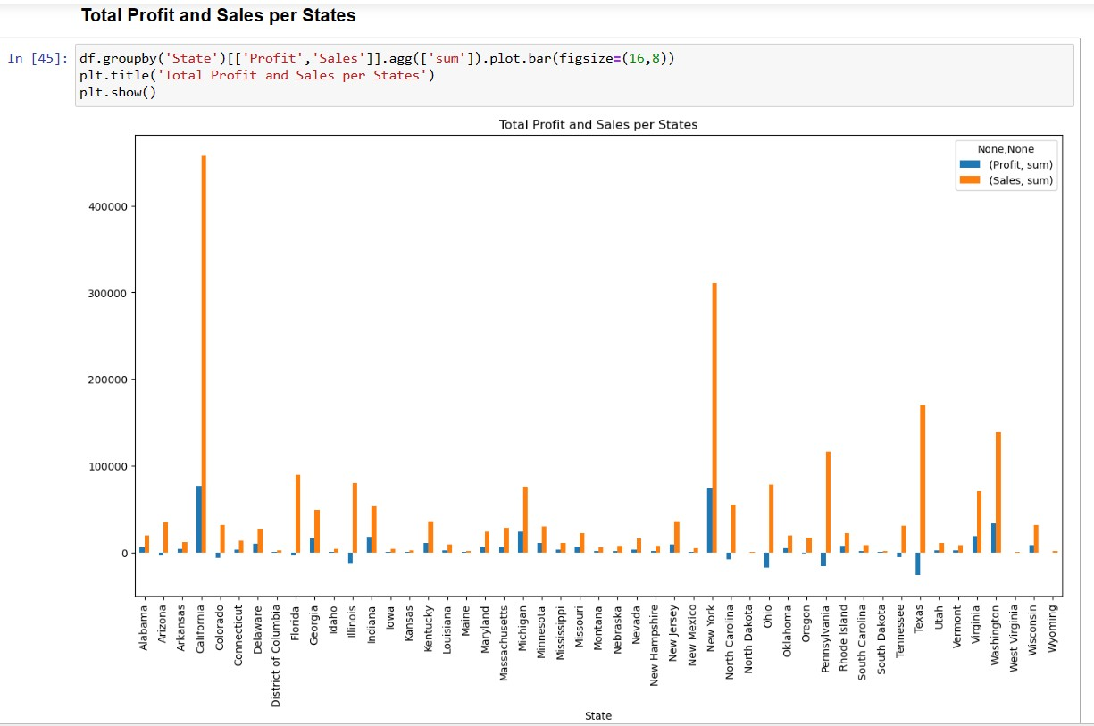

Slide 18
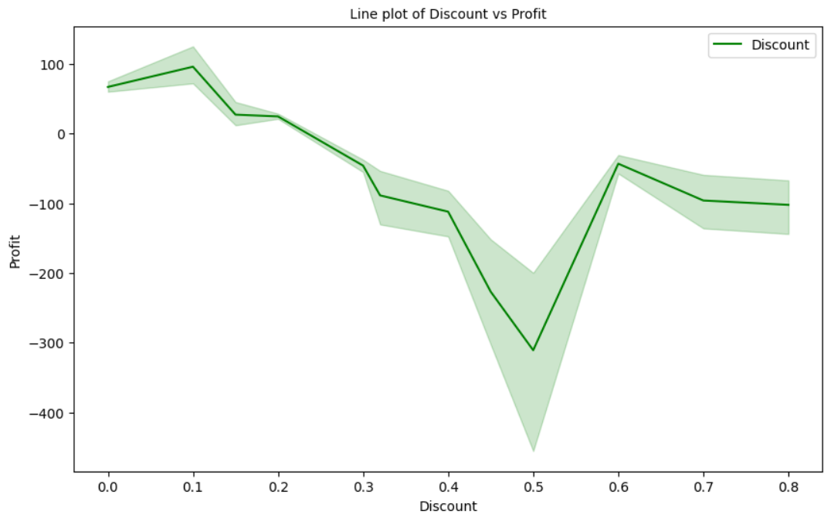

Slide 19
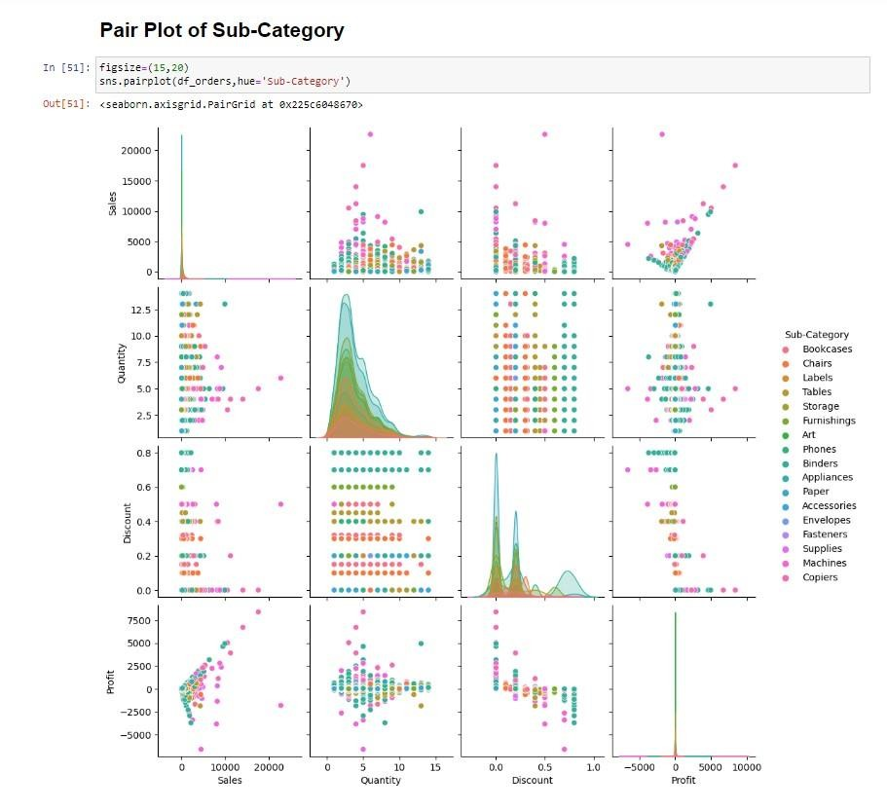

Slide 20
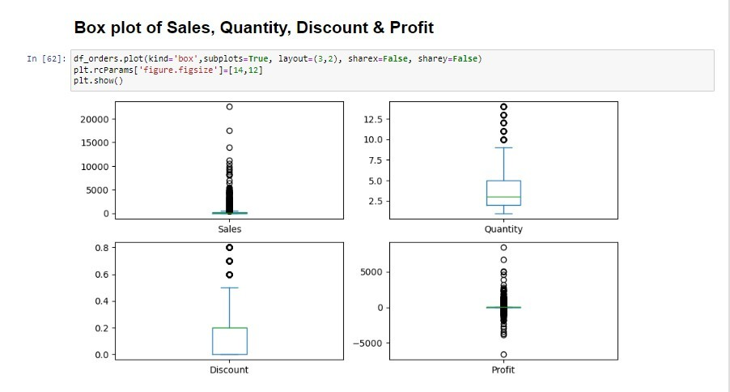

Slide 21
RESULTS OF ANALYSIS
Key Insights: The key findings of the Sales and Profit Analysis are summarized, including the highest-
selling regions, cities, and sub-categories, as well as the most profitable areas –
Sale of products in the Technology Category results in Maximum Profit Margin, more
specifically Copiers, Fasteners, Accessories and Phones, followed by Office Supplies including Labels, Papers and Envelopes. Chairs are the only product in the Furniture Category which is profitable, other products of this category results in Loss
The Segment- Home Office is the most profitable, followed by Corporate
Sales in the West Region has the Highest Profitability, followed by the East while that in
the Central Region suffers the Highest Loss

Slide 22
RESULTS OF ANALYSIS
Actionable Insights: Actionable insights derived from the analysis are presented, highlighting the
areas where optimization opportunities exists for sales improvement and profitability enhancement –
To ensure Maximum Profit, the production in the Technology Sector must be upgraded so that the
products mentioned above are available to the customers in required quantity so as to always remain
ahead of the Market Demand.
Suitable actions must be taken ensure Profit in the Furniture Category for products other than Chairs
or else the cost of production of those commodities must be reduced.
More products of the Segment- Home Office must be produced so as to ensure abundant supply and
maximum profit of the Superstore.
The Sales in the Central Region of the United States must be inspected for the cause of overall Loss
and suitable steps must be taken to rectify the same to ensure Profit.

Slide 23
CONCLUSION
The Superstore dataset analysis has yielded valuable insights into sales trends, customer behavior, and operational efficiency.
Key findings include seasonal sales patterns, profitable product categories, and actionable customer segmentation.
These insights support proactive decision-making, improved profitability, and enhanced customer satisfaction and retention.
Moving forward, continuous monitoring of sales performance and operational metrics is recommended to adapt to market dynamics and evolving customer preferences.
Ultimately, this project showcases the significant impact of data analytics on strategic decision-making and operational success in the competitive retail market.

Slide 24
LINKS
GitHub Repository Link:
https://github.com/shubhamdhopat/Analysis_Superstore_Dataset
Dataset Link:
https://www.kaggle.com/datasets/bravehart101/sample-supermarket-dataset
Source Code (Google Colab):
https://colab.research.google.com/drive/1cRonyBULtCGhOL5t5m14Ul15FMleNY6D#scrollTo=iTIgJqsRSy3P
…ThankYou

